Slide 1

Team Name : Cognitive Codex
Team Leader Name : Aswini Kumar Sahu
Problem Statement : AI analyst for startup evaluation

Slide 2
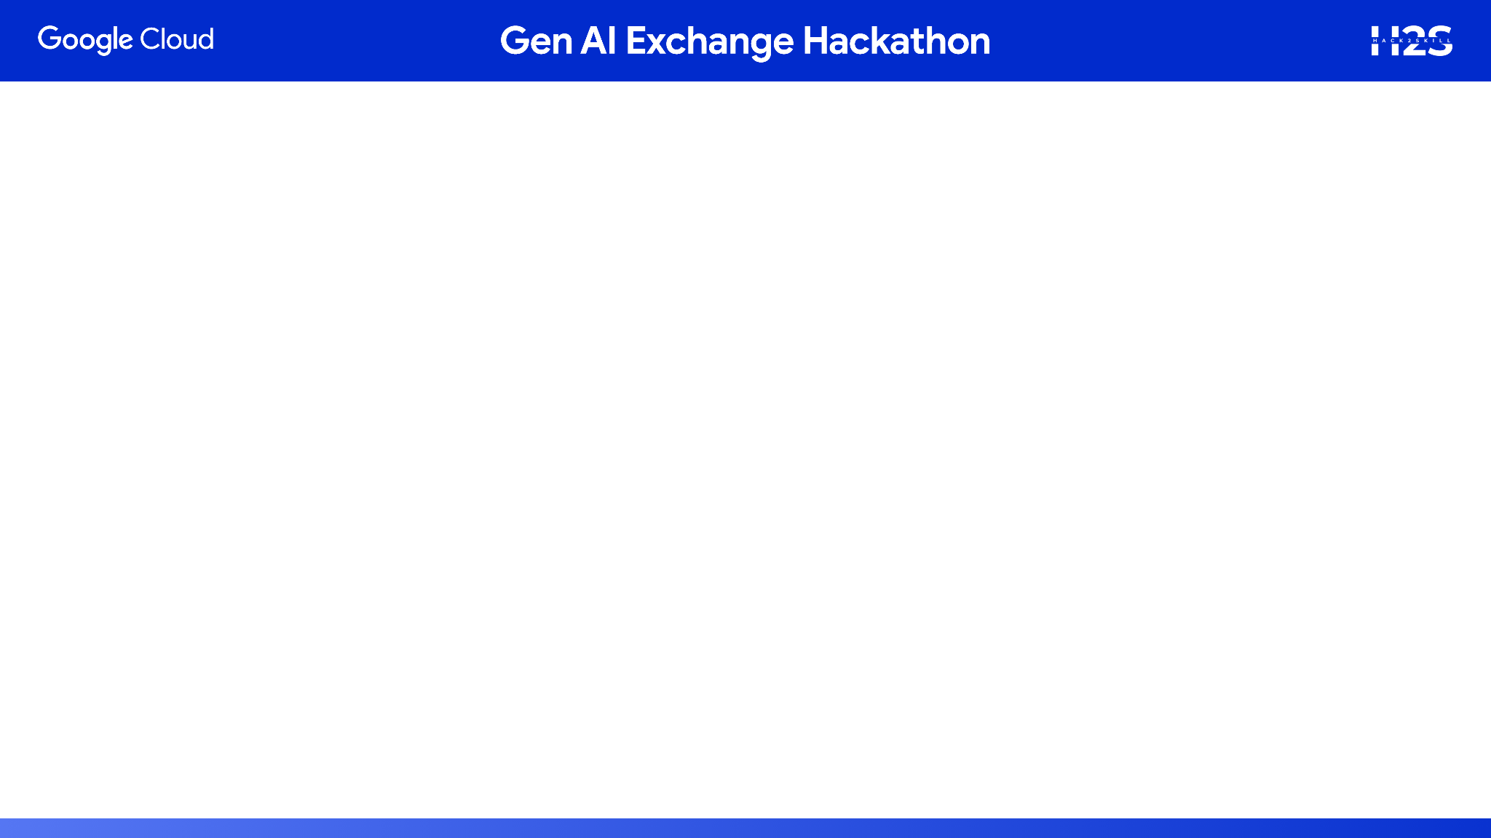
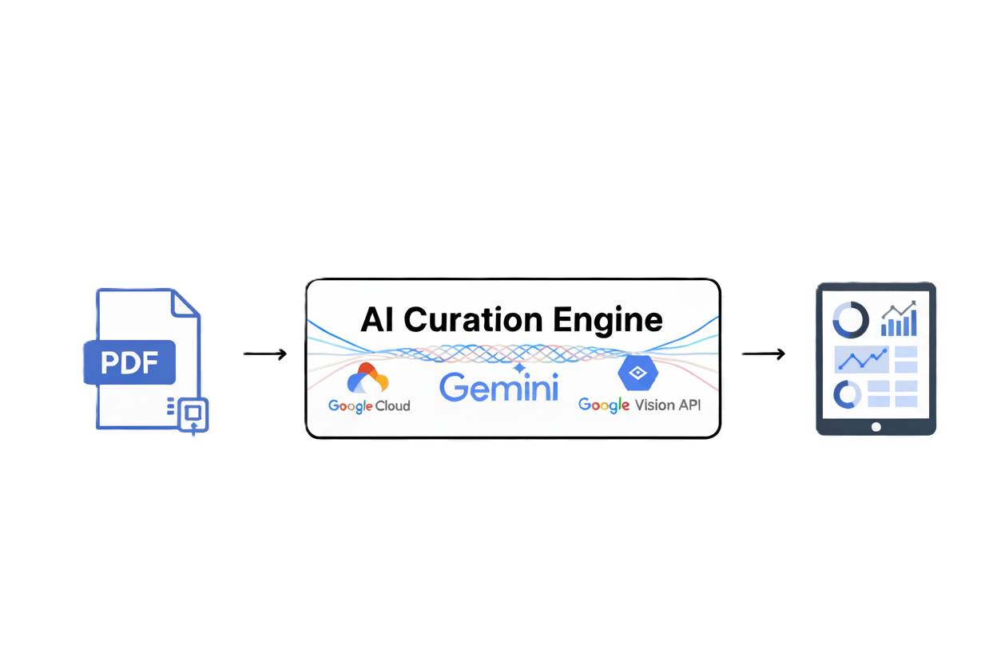
Brief about the prototype: “The Autonomous Founder-to-Investor Pipeline”
Our vision is a fully autonomous platform that manages the entire startup evaluation lifecycle, from a founder's upload to a personalized investor report.
For this hackathon, we have built a working prototype that demonstrates the core of this vision. Our prototype successfully executes:
1. Automated Analysis & Memo Generation:
It begins by ingesting a founder's pitch deck. A team of AI agents then automatically synthesizes the deck's content with public web data to produce a comprehensive, data-rich "Investment Memo."
2. Personalized Reporting & Ranking:
Using this generated memo, the prototype delivers a dynamic weighting engine.
This allows an investor to input their personal priorities and instantly generate a final, ranked, and reasoned investment report.

Slide 3
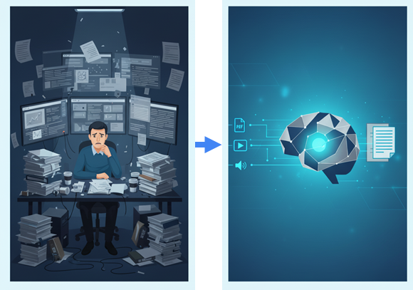
Opportunity in the Solution: “The Autonomous Diligence Engine”
Existing solutions are passive; they only analyze what they're given. Our system is active. Its AI Voice Agent proactively engages founders in conversation to clarify, challenge, and enrich data, a task that has always been exclusively human.
From Single-Format to True Multi-Modal Synthesis: Competitors might process a PDF. Our engine natively ingests, understands, and synthesizes a founder's entire narrative across video pitches, audio notes, and text documents into a single, cohesive analysis.

Slide 4
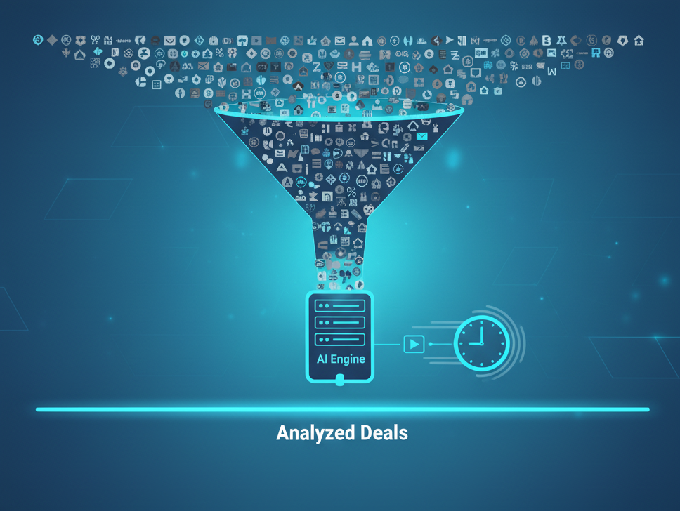
USP (Unique Selling Proposition) of the proposed solution:
Our USP is the Autonomous Diligence Engine with Active AI Dialogue. We are not just processing documents; we are building an autonomous system that can think, investigate, and converse. It replicates the entire cognitive and interactive workflow of a human analyst team, from initial research to direct founder engagement, creating a level of speed and scalability that is impossible to achieve with a human-in-the-loop process.
.

Slide 5

Feature 1: Fully Autonomous, Multi-Modal Ingestion
List of features offered by the solution:
This foundational feature empowers founders to seamlessly submit their application materials in virtually any format, eliminating traditional submission barriers.
Whether it's a detailed pitch deck in PDF/PPT, an engaging video presentation, or concise audio notes, our system automatically processes, extracts, and structures all incoming data.
This ensures a comprehensive initial data capture, setting the stage for subsequent intelligent analysis without manual intervention.

Slide 6
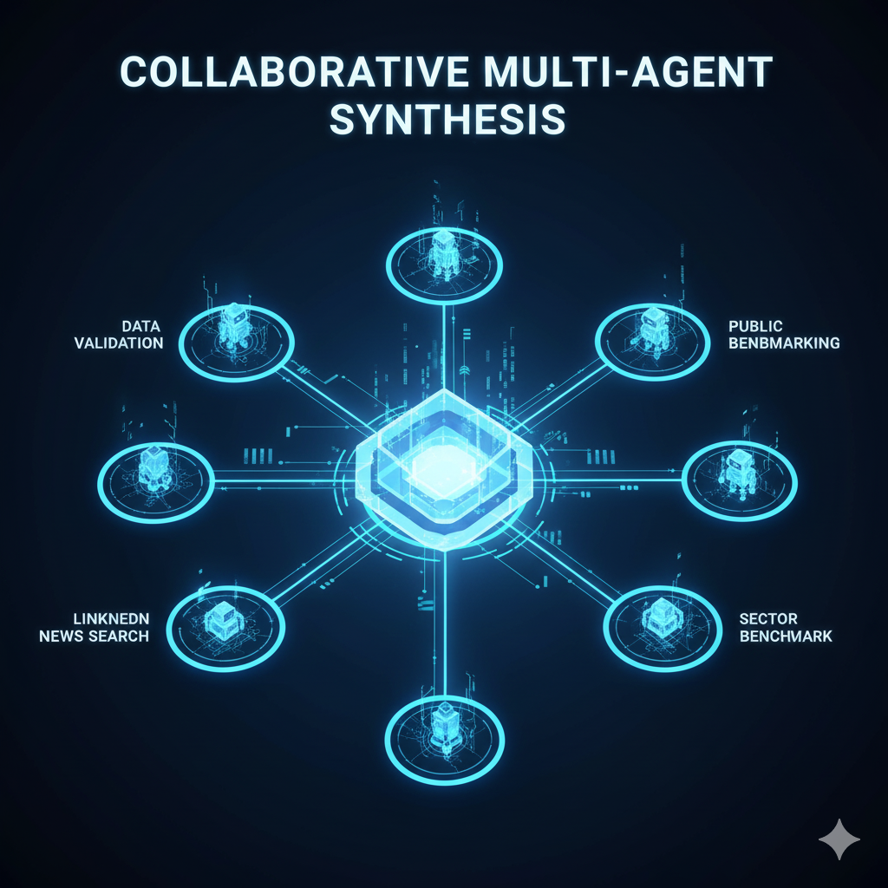
Feature 2: Collaborative Multi-Agent Synthesis
This feature employs a sophisticated team of specialized AI agents that work in concert to thoroughly synthesize and validate incoming data.
These agents cross-reference claims against a multitude of external sources, including public news, professional networks like LinkedIn, and dedicated data intelligence platforms such as Tracxn.
Simultaneously, they benchmark the startup's performance against relevant sector-specific Key Performance Indicators (KPIs), ensuring a robust and well-rounded initial assessment.

Slide 7

Feature 3: AI-Powered Founder Dialogue
This revolutionary feature leverages a proprietary AI Voice Agent to conduct proactive and structured conversations with founders.
After analyzing initial findings to pinpoint information gaps or ambiguities, the AI autonomously engages the founder in a natural dialogue.
This innovative interaction clarifies details and enriches the data set, effectively automating a critical diligence step that has historically required significant human analyst time.

Slide 8
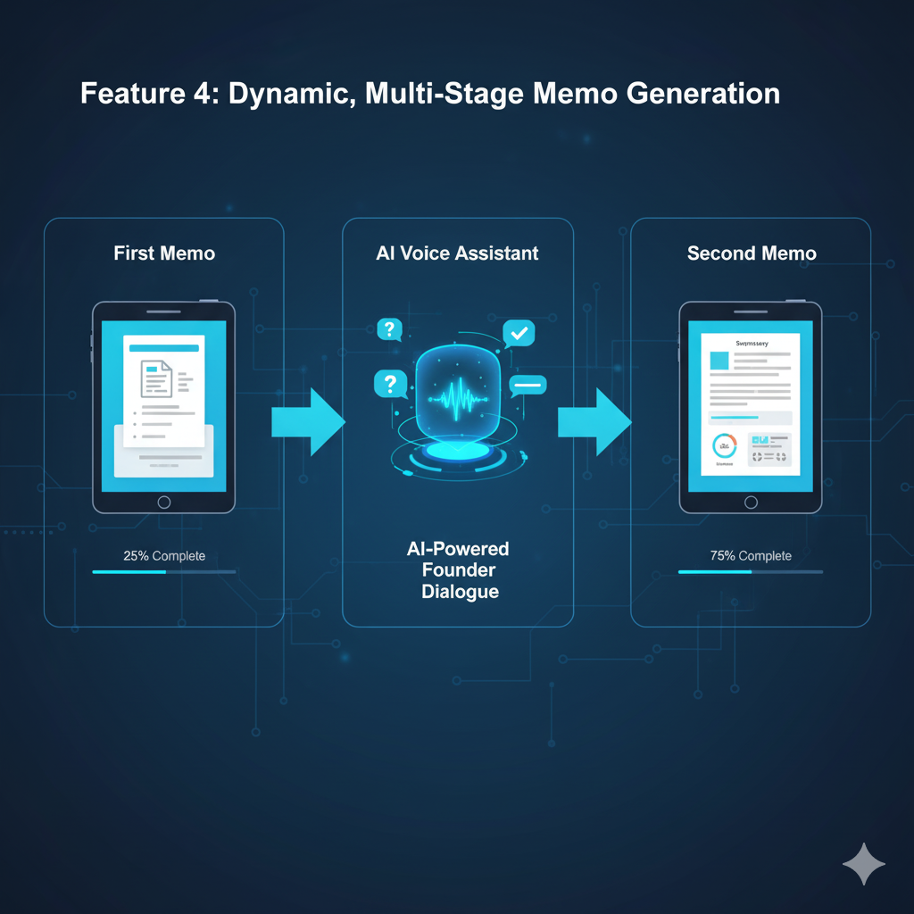
Feature 4: Dynamic, Multi-Stage Memo Generation
This feature outlines the intelligent evolution of the startup's evaluation report. The system first produces a "First Memo," a comprehensive initial report based on the synthesized data gathered during the ingestion and multi-agent analysis phase.
Following the interactive AI-powered founder dialogue, the system generates an enriched "Second Memo," which incorporates the newly acquired clarifications and deeper insights
.
This dynamic, multi-stage approach creates a continuously evolving and thoroughly documented diligence trail.

Slide 9
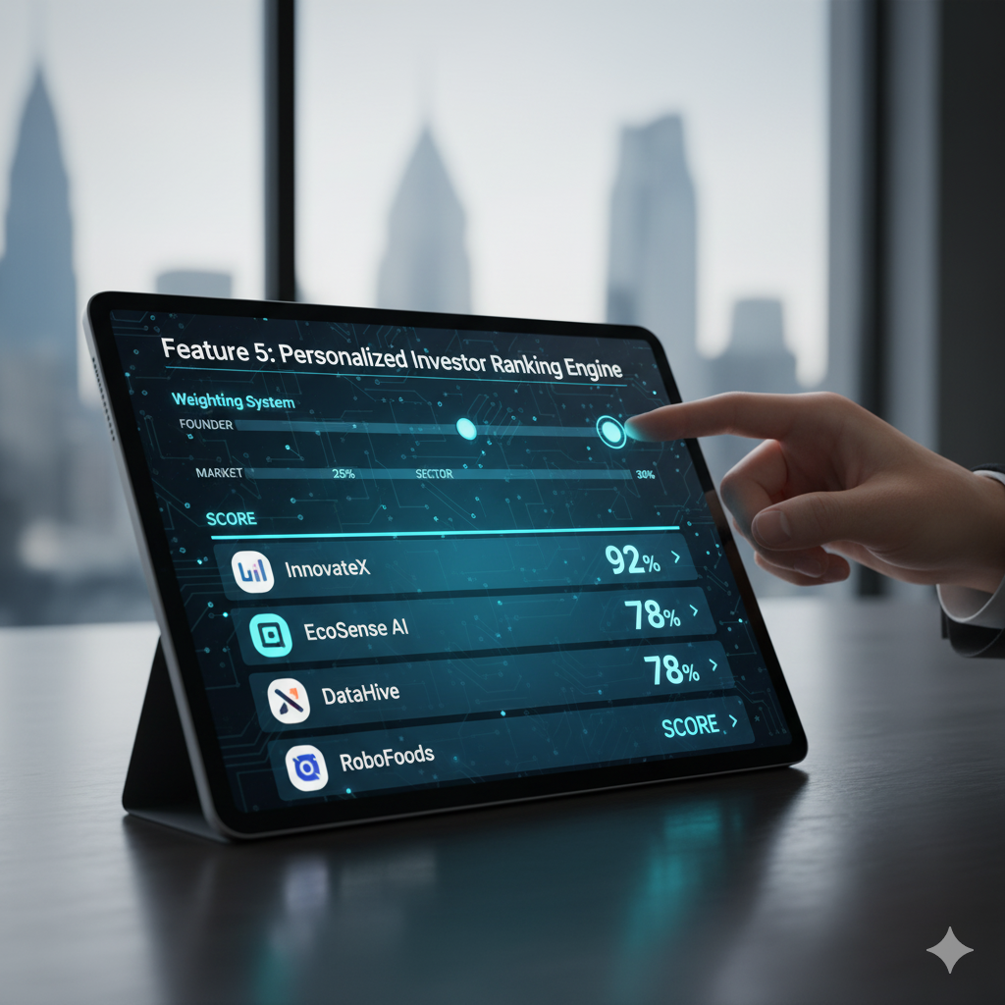
Feature 5: Personalized Investor Ranking Engine
This feature provides investors with a powerful tool to tailor startup evaluations to their specific investment thesis.
Investors can input their unique preferences via a simple weighting system, customizing factors such as "Founder," "Market," and "Sector."
The engine then intelligently scores and ranks all thoroughly vetted startups precisely according to these personal criteria, delivering highly relevant and actionable investment recommendations that align perfectly with their strategic priorities.

Slide 10
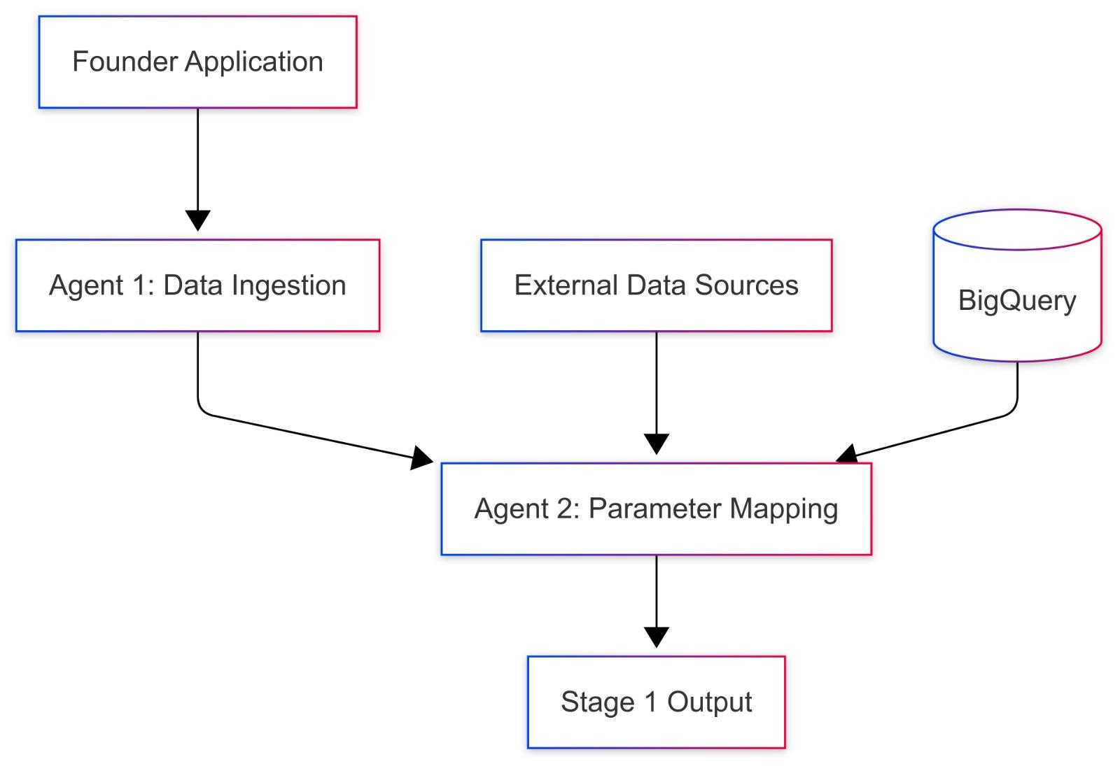
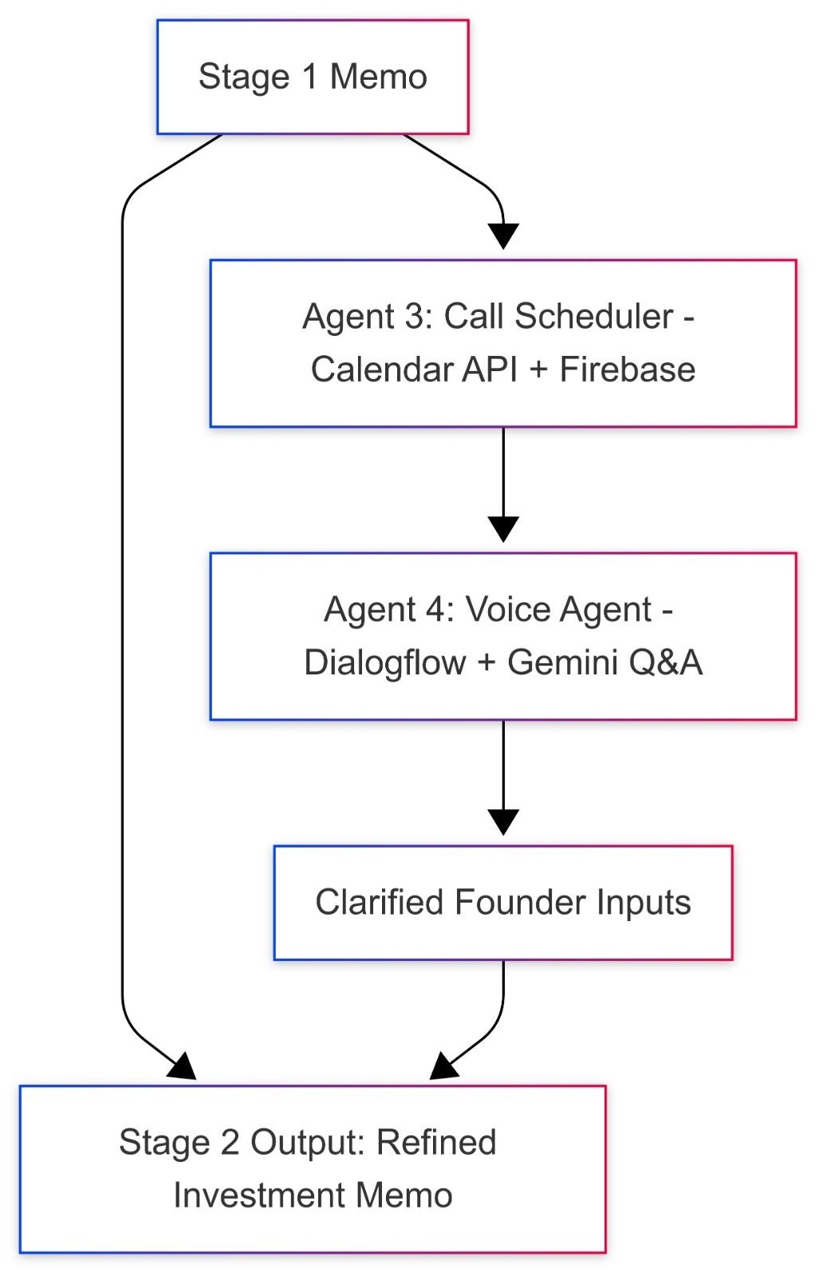
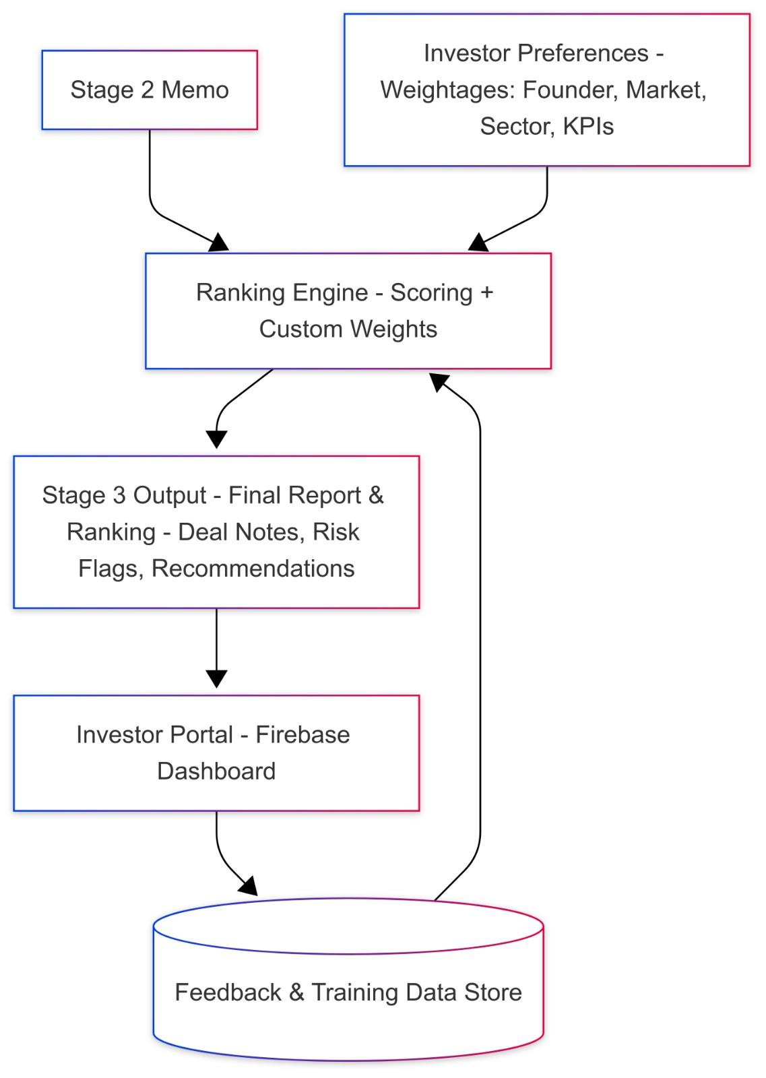
Process flow diagram or Use-case diagram

Slide 11
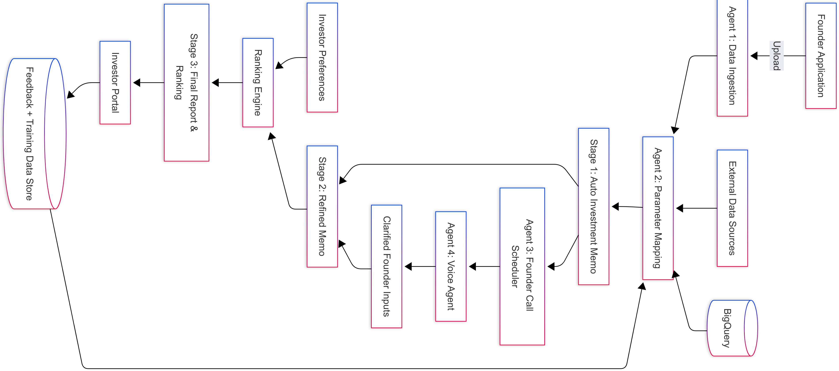
Architecture of the proposed solution:
Here’s the complete architecture of the Product:

Slide 12


